Slide 1

CHAPTER 4:
MICROSOFT OFFICE WORD 2007
MAIL MERGE
Notes:
[Notes to trainer:
For detailed help in customizing this template, see the very last slide. Also, look for additional lesson text in the notes pane of some slides.
Adobe Flash animations: This template contains Flash animations. These will play in PowerPoint 2000 and later. However: If you want to save this template in PowerPoint 2007, save it in the earlier PowerPoint file format: PowerPoint 97-2003 Presentation (*.ppt) or PowerPoint 97-2003 Template (*.pot) (you’ll see the file types in the Save As dialog box, next to Save as type).
Warning: If you save it in a PowerPoint 2007 file format, such as PowerPoint Presentation (*.pptx) or PowerPoint Template (*.potx), the animations won’t be retained in the saved file.
Also: Because this presentation contains Flash animations, saving the template may cause a warning message to appear regarding personal information. Unless you add information to the properties of the Flash file itself, this warning does not apply to this presentation. Click OK on the message.]

Slide 2

How it works

Slide 3
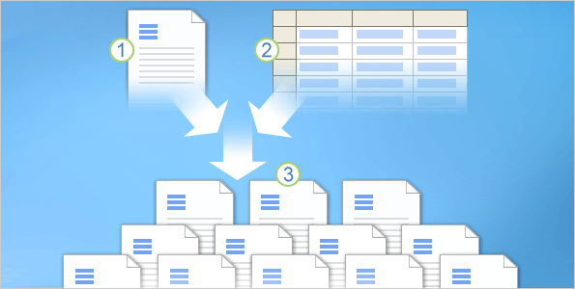



In any mail merge, you’ll deal with three different elements.
Understanding these elements will help you get the mail merge results you want and expect.
The main document that you start with.
Recipient information, such as each person’s name and address that you want to merge with the main document.
The finished documents, which include the information in the main document plus each recipient’s unique information.
Mail merge: Use mail merge for mass mailings
Notes:
Later in the course, we’ll get into the details about how to perform a mail merge.

Slide 4
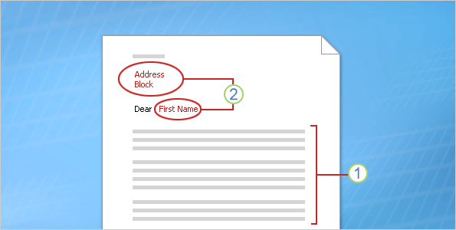
The main document is your starting point. The main document can be a letter, envelope, e-mail, or even a coupon.
It contains the elements shown here.
Content that is identical in each copy, such as the main body text of a form letter. You only have to type this text once, regardless of how many letters you intend to print.
Placeholders for each recipient’s information. For example, in a form letter, the address block and greeting name would be unique in each copy.
Mail merge: Use mail merge for mass mailings

Slide 5
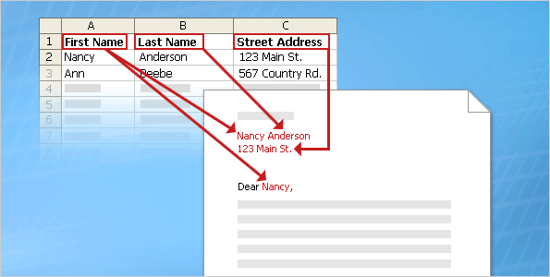
In a mail merge, the recipient’s information, which is unique in each merged copy, fills in for the placeholders that you added to the main document.
Recipient information might be: Addresses on envelopes or labels; names in the greeting line of a form letter; salary amounts in e-mail messages that you send to your employees; personal notes about favorite products in postcards that you mail to your best customers; or numbers on redeemable coupons.
Mail merge: Use mail merge for mass mailings

Slide 6
Recipient information must be kept in a data source.
“Data source” is an umbrella term that covers a whole category of files you work with all the time.
For example, your Microsoft Office Outlook® contacts list is a data source.
Mail merge: Use mail merge for mass mailings
Notes:
Other examples of data sources include: a Word table, a Microsoft Office Excel™ worksheet, a Microsoft Office Access® database, or even a text file.

Slide 7
The recipient information is usually listed in columns and rows, as shown in the table in the picture.
The data source file must be structured in a way that makes it possible to link specific information with the placeholders in the main document.
Mail merge: Use mail merge for mass mailings
Notes:
You’ll learn how to set up a recipient list and connect to it in the next lesson.

Slide 8
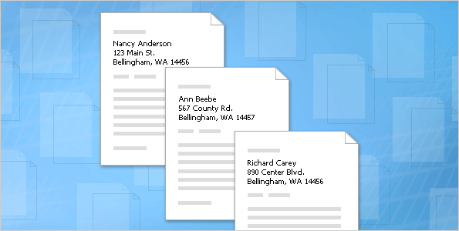
When you finish a mail merge, you get what’s pictured here.
The set of individual finished documents, which you can print (for example, letters, labels, envelopes, or coupons) or which you can transmit electronically during the merge process (for example, e-mail messages).
Mail merge: Use mail merge for mass mailings

Slide 9
When you finish a mail merge, you get what’s pictured here.
The main document. This is the document you used as a starting point, which remains a separate document. It is not automatically saved after the merge.
Mail merge: Use mail merge for mass mailings
Notes:
You should save the main document because Word will remember which recipient list you connected to it and when you open it again, you can quickly complete a new mail merge.
Note: Optionally, if you’re creating letters, envelopes, or labels, you can also generate a “comprehensive document” that contains all the merged documents in one file. More on this at the end of the last lesson.

Slide 10
Set up your recipient list

Slide 11
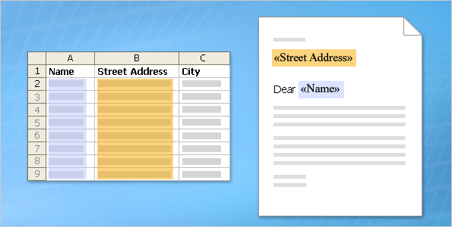
You know what the basic elements of a mail merge are.
Now you’ll learn how to set up your main document and connect it to the recipient list.
The recipient list, along with the placeholders that you add to your Word document or envelope, is the heart and soul of mail merge.
They work together to get unique information into the final individually merged copies.
Mail merge: Use mail merge for mass mailings
Notes:
After you understand what these two key components are and how they relate, you’ll be able to set up and run successful mail merges.

Slide 12
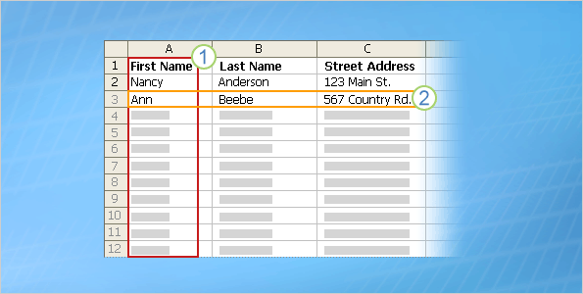
A recipient list can be any file that organizes recipient information into columns and rows. You can create it using lots of different programs, such as Excel, Access, or Outlook.
The columns in a list represent a category or type of information. Each column is identified by a column heading. For example, in a customer list you might have columns for Name, Last Name, and Street Address.
Mail merge: Use mail merge for mass mailings

Slide 13
A recipient list can be any file that organizes recipient information into columns and rows. You can create it using lots of different programs, such as Excel, Access, or Outlook.
Each row in a list represents one recipient’s complete information. In the customer list, for example, one row contains all the information about one customer: the customer’s name, address, and so on.
Mail merge: Use mail merge for mass mailings

Slide 14
It’s these columns and rows that make it possible to get unique recipient information into documents during a mail merge.
From the main document, you connect to the list and then you can add any column heading as a placeholder into the main document. (Officially, these placeholders are called fields. More on fields in a moment.)
Mail merge: Use mail merge for mass mailings
Notes:
Officially, these placeholders are called fields. More on fields in a moment.

Slide 15
It’s these columns and rows that make it possible to get unique recipient information into documents during a mail merge.
When the mail merge is complete, there will be a finished document for each person that contains information from the entries in one row of the recipient list.
Mail merge: Use mail merge for mass mailings
Notes:
Tip: For the best results, set up your recipient list so that each column represents the smallest possible piece of information. For example, use separate columns for First Name and Last Name rather than just a Name column. This gives you the most flexibility when you arrange fields in the main document and lets you, for example, greet customers by their first names.

Slide 16
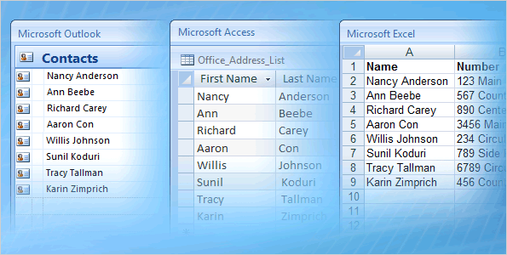
In many cases, the recipient list that you want to use will already exist.
For example, you might have access to a file with a list of the following.
Customer or contact names, addresses, and more.
The products or services your company offers.
Information about your employees.
Mail merge: Use mail merge for mass mailings

Slide 17
If the list exists, you can just connect it during the mail merge.
But don’t worry if you don’t have a list yet. The mail merge process includes a step where you can create a recipient list from scratch. More on this in the next lesson.
Mail merge: Use mail merge for mass mailings
Notes:
Note: You can make changes to the data in the recipient list at any time by opening the Mail Merge Recipients dialog box during the merge or by opening the data source file directly.

Slide 18
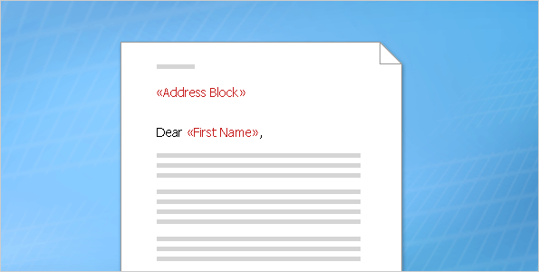
After you connect to the recipient list, you can specify the information that you want to include in the mail merge by using fields.
A field is a set of codes that instructs Word to insert information into a document automatically.
Informally, you can think of fields as placeholders.
Mail merge: Use mail merge for mass mailings

Slide 19
In a mass mailing, the fields you use are called merge fields, and they are the placeholders for the unique information that comes directly from a recipient list.
For example, in the illustration, merge fields have been added for information stored in the Address and Name columns of a recipient list.
Notice that they’re surrounded by chevrons (« ») in a document.
Mail merge: Use mail merge for mass mailings

Slide 20
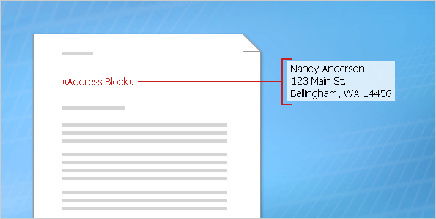
You can create a merge field by combining other fields, or group fields and then use spaces, line breaks, and punctuation marks as you would normally in a sentence.
For example, you might want to create a courtesy title before the surname or full name and set up fields in your document like this:
«Title» «Last Name»
«Street Address»
«City», «State» «Postal Code»
Mail merge: Use mail merge for mass mailings

Slide 21
You can also control how recipient information looks in the merged documents by formatting the fields.
For example, you might want names to be bold or colored red.
In the main document, select the field, including the surrounding chevrons (« »). On the Home tab, click any command in the Font group or the Paragraph group, and choose the formatting options you want.
Mail merge: Use mail merge for mass mailings
Notes:
You can also click the Dialog Box Launcher for either of these groups to see formatting options.

Slide 22
Perform a complete mail merge

Slide 23
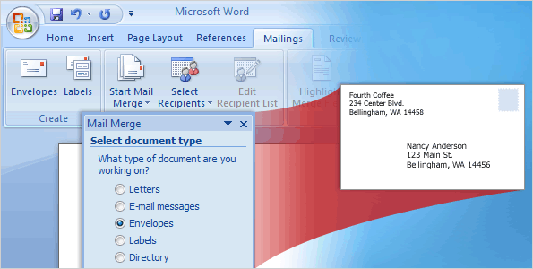
Now you’ll walk through the process of performing a mail merge by using the Mail Merge Wizard.
At the end of this lesson you will learn about another way to perform a mail merge.
Mail merge: Use mail merge for mass mailings

Slide 24

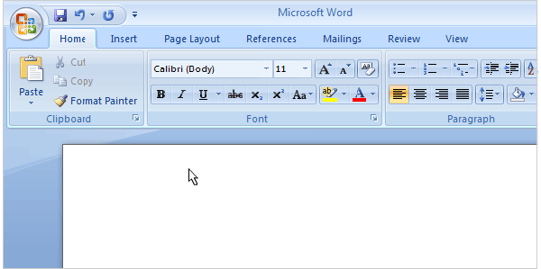
To perform a mail merge, click Start Mail Merge on the Mailings tab, and then click Step by Step Mail Merge Wizard.
The wizard opens on the right of the window in a task pane. Follow the prompts and click Next at the bottom of the pane to step through the wizard (or Previous if you need to go back to an earlier step).
Mail merge: Use mail merge for mass mailings
Notes:
In Step 1, the wizard opens with a question. It wants to know what type of document you want to merge information into. The animation illustrates how to open the wizard and select Envelopes as the document type.
Tip: The task pane can be moved (undocked) by clicking the title bar and dragging it to a new location. You can also resize it by dragging a resize handle on the sides of the task pane.
[Note to trainer: To play the animation when viewing the slide show, right-click the animation, then click Play. After playing the file once, you may have to click Rewind (after right-clicking) and then click Play. If you’re clicking the slide to make text enter or to advance to the next slide but nothing’s happening, click away from the animation. Sometimes you have to click twice. If you have problems viewing the animation, see the notes for the last slide in this presentation about playing an Adobe Flash animation. If you still have problems viewing the animation, the slide that follows this one is a duplicate slide with static art. Delete either the current slide or the next slide before showing the presentation.]

Slide 25

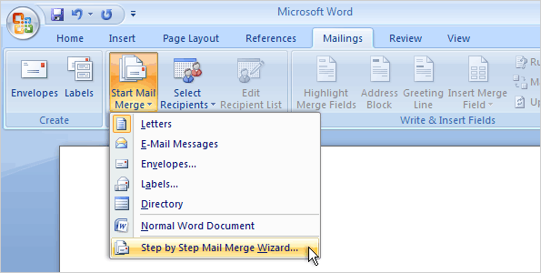
To perform a mail merge, click Start Mail Merge on the Mailings tab, and then click Step by Step Mail Merge Wizard, as shown here.
The wizard opens on the right of the window in a task pane. Follow the prompts and click Next at the bottom of the pane to step through the wizard (or Previous if you need to go back to an earlier step).
Mail merge: Use mail merge for mass mailings
Notes:
In Step 1, the wizard will open with a question about what type of document you want to merge information into.
Tip: The task pane, not shown here, can be moved (undocked) by clicking the title bar and dragging it to a new location. You can also resize it by dragging a resize handle on the sides of the task pane.
[Note to trainer: This slide is identical to the preceding slide except that it has static art instead of an animation. Use this slide if you have problems viewing the animation. Delete either the current slide or the preceding slide before showing the presentation.]

Slide 26
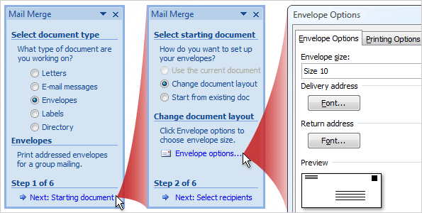
The second step in the wizard is to set up the starting document.
You may be sending a direct mail letter, or an e-mail message, or perhaps you want to start with envelopes and labels.
Or you may want to create a directory to store listings of data, such as customer names and addresses, product information, and personnel contact data.
Mail merge: Use mail merge for mass mailings

Slide 27
The options in the wizard vary according to the type of document selected in the first step.
You selected envelopes, which has these options.
Change document layout. This option is selected because a blank document was open when you started the wizard. You want to change the open blank document to an envelope document. Click Envelope options and choose the envelope size and other options you want, and then the envelope document replaces the blank document.
Mail merge: Use mail merge for mass mailings

Slide 28
The options in the wizard vary according to the type of document selected in the first step.
You selected envelopes, which has these options.
Start from existing document. If you have a previously saved envelope that you want to use for the mail merge, but your screen currently has a blank document open, select this option to replace the blank document with your envelope.
Mail merge: Use mail merge for mass mailings
Notes:
Note: The Use the current document option is not available when you start with a blank document. Current document means the document currently open on your screen. If you had first opened an envelope document and then started the wizard, you could use this option.

Slide 29
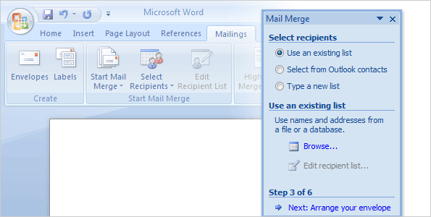
In Step 3, you connect to the recipient list that you want to merge into your documents.
You have three options.
Use an existing list. If you already have a recipient list that contains the information you want to merge, select this option.
Then, click Browse in the wizard to locate and open that file.
Mail merge: Use mail merge for mass mailings

Slide 30
In Step 3, you connect to the recipient list that you want to merge into your documents.
You have three options.
Select from Outlook contacts. If you want to use your Outlook contacts list as your recipient list, select this option.
Then, click Choose Contacts Folder to locate and open the correct contacts list.
Mail merge: Use mail merge for mass mailings

Slide 31
In Step 3, you connect to the recipient list that you want to merge into your documents.
You have three options.
Type a new list. If you don’t have an appropriate recipient list and want to create one, select this option. The new list is saved as a mailing database (.mdb) file in the My Data Sources folder, which is located in your Documents or My Documents folder.
You can reuse the file for future mail merges.
Mail merge: Use mail merge for mass mailings
Notes:
Tip: During the mail merge process, when you connect to the recipient list you want to use in the merge, Word looks first for the file in a folder called My Data Sources in your Documents or My Documents folder. It’s probably most convenient, therefore, to store your recipient list there. But, you can connect to any recipient list in any location on your computer or on a server.

Slide 32

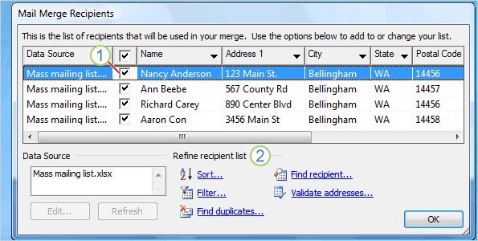
After you connect to the recipient list, you choose the recipients that you want to include in your mailing.
For example, you might want to send a form letter to only those customers in your file with a specific postal code.
Or, you might want to create a directory that includes only one product line.
Mail merge: Use mail merge for mass mailings

Slide 33

You do all this in the Mail Merge Recipients dialog box, which opens automatically after you connect to or create a recipient list.
All the recipients have a check mark next to their name and are included in the mailing by default.
Mail merge: Use mail merge for mass mailings
Notes:
You can clear the check mark for individual recipients or clear all the recipients by clearing the check box in the column heading then check the box next to the name of the person you want to include in your mailing.

Slide 34
You do all this in the Mail Merge Recipients dialog box, which opens automatically after you connect to or create a recipient list.
Refine the recipient list by clicking Sort… to choose the column name that you want to view and arrange (either ascending or descending); or clicking Filter… to enter the fields and values of the recipients that you want to view.
Mail merge: Use mail merge for mass mailings
Notes:
You can also click Find duplicates… to run a report that lists the recipients that might be in your list more than once; or click Find recipient… to locate a specific person. The Validate addresses… feature is available if you have a validation program installed.

Slide 35

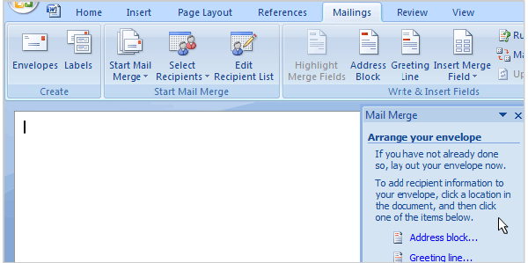
Next, you arrange the main document, which means putting content into it.
That content consists of information that stays the same in each merged copy, and placeholders (fields) for the recipient information in each merged copy.
Mail merge: Use mail merge for mass mailings
Notes:
For an envelope, the information that stays the same in each merged copy is the return address that you type in the upper left corner. The placeholders are the addresses of each recipient.
As the animation shows, the quickest way to add a delivery address is to click Address block in the wizard. It adds a pre-designed «AddressBlock» field to the envelope, which includes First Name, Last Name, Street Address, City, State, and Postal Code.
Tip: You can assemble your own address block if you prefer. Click More items in the wizard to open the Insert Merge Field dialog box where, with the Database Fields option selected, you see a list of the column headings in your recipient list. You can insert any of these into your main document as a field.
[Note to trainer: To play the animation when viewing the slide show, right-click the animation, then click Play. After playing the file once, you may have to click Rewind (after right-clicking) and then click Play. If you’re clicking the slide to make text enter or to advance to the next slide but nothing’s happening, click away from the animation. Sometimes you have to click twice. If you have problems viewing the animation, see the notes for the last slide in this presentation about playing an Adobe Flash animation. If you still have problems viewing the animation, the slide that follows this one is a duplicate slide with static art. Delete either the current slide or the next slide before showing the presentation.]

Slide 36
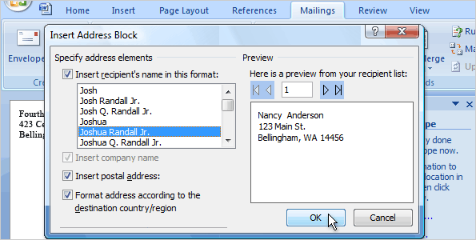
Next, you arrange the main document, which means putting content into it: the information that stays the same in each merged copy, and placeholders for the recipient data in each merged copy.
For an envelope, the information that stays the same in each merged copy is the return address that you type in the upper left corner. The placeholders are the addresses of each recipient.
Mail merge: Use mail merge for mass mailings
Notes:
[Note to trainer: This slide and the next slide are equivalent to the preceding slide, but they have static art instead of an animation. Use these two slides if you have problems viewing the animation. Delete either the current slide or the preceding slide before showing the presentation.]

Slide 37
The quickest way to add a delivery address is to click Address block in the wizard.
It adds a pre-designed «AddressBlock» field to the envelope, which includes First Name, Last Name, Street Address, City, State, and Postal Code.
Mail merge: Use mail merge for mass mailings
Notes:
Tip: You can assemble your own address block if you prefer. Click More items in the wizard to open the Insert Merge Field dialog box where, with the Database Fields option selected, you see a list of the column headings in your recipient list. You can insert any of these into your main document as a field.
[Note to trainer: This slide and the previous slide are equivalent to the preceding slide, but they have static art instead of an animation. Use these two slides if you have problems viewing the animation. Delete either these two slides or the slide with the animation before showing the presentation.]

Slide 38
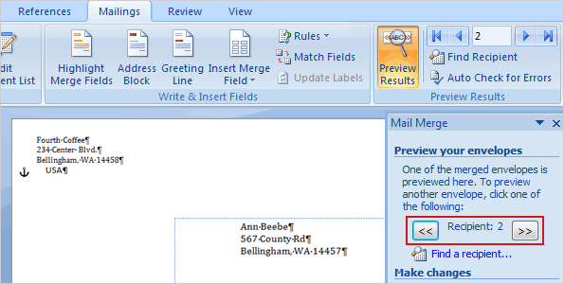
After you’ve added all the content and fields to the main document, you’re ready to preview how the merged documents will look.
When you click Next at the bottom of the wizard to move to the next step, the first merged document automatically appears.
Mail merge: Use mail merge for mass mailings

Slide 39
Depending on how the first document looks, you have several choices:
If things don’t look right, click Previous at the bottom of the wizard. By returning to the previous step, you can add, delete, or match fields, or make other corrections so that the information is displayed correctly.
If things look good, click the double right arrow button at the top of the wizard to page through a few more of the merged documents, as shown in the picture.
Mail merge: Use mail merge for mass mailings
Notes:
Tip: When you preview, if you still see fields and chevrons in your document instead of the values for those fields, click the Preview Results on the Mailings tab. Besides showing the individual merged documents, the Preview Results command also toggles between showing the field codes and showing their values.

Slide 40
Depending on how the first document looks, you have several choices:
If you want to view the merged document for a particular recipient, click Find a recipient to search for that person. As you page through the documents, you can exclude any person from the merge by clicking Exclude this recipient.
Note that you’re excluding a recipient only from the final merge results, not deleting anything from the recipient list.
If you realize that the merge includes some recipients you don’t actually want to include, click Edit recipient list to open the Mail Merge Recipients dialog box. As described previously, you can use this dialog box to narrow down the recipient list.
Mail merge: Use mail merge for mass mailings

Slide 41
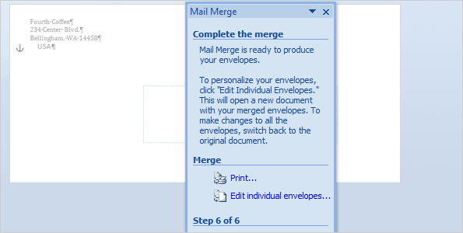
When you’re satisfied with previews of the merged documents, you’re ready to print the final results.
Click Print to open the Merge to Printer dialog box.
Last minute changes?
If you still want one more chance to review the results, or if you want to customize selected envelopes, click Edit individual envelopes in the wizard.
Mail merge: Use mail merge for mass mailings

Slide 42
When you’re satisfied with previews of the merged documents, you’re ready to print the final results.
Click Print to open the Merge to Printer dialog box.
This creates a separate comprehensive merge that contains all the envelopes in a new Word document.
After you review or modify the envelopes in this comprehensive document, you can print them immediately.
Mail merge: Use mail merge for mass mailings

Slide 43
When you’re satisfied with previews of the merged documents, you’re ready to print the final results.
Click Print to open the Merge to Printer dialog box.
Or, just save the document and print the envelopes later. If you want to keep the changes you made to individual envelopes, make sure you save this document.
This comprehensive document is separate from the main document and will be larger in size.
Mail merge: Use mail merge for mass mailings
Notes:
Caution: If you create a set of merged e-mail messages, preview the messages carefully before you complete the merge. With e-mail messages, you won’t have the option of creating a separate comprehensive document. After you click Electronic Mail in the wizard and identify the column in your recipient list that contains the recipients’ e-mail addresses, the messages get sent.

Slide 44
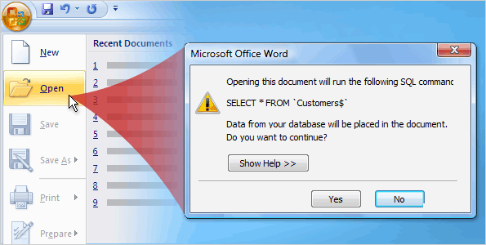
You can cancel your mail merge at any time before completing it.
To do this, close the document and choose not to save the changes. The document will be deleted along with the connection to the recipient list.
But if you just need to stop working on the merge and want to come back to it later, save the main document.
Mail merge: Use mail merge for mass mailings
Notes:
By saving the main document you will retain the connection to the recipient list as well as the fields you added to the document.

Slide 45
You can cancel your mail merge at any time before completing it.
When you open the document again, Word will ask if you want to keep the connection to the recipient list. Click Yes to resume the merge.
Mail merge: Use mail merge for mass mailings

Slide 46

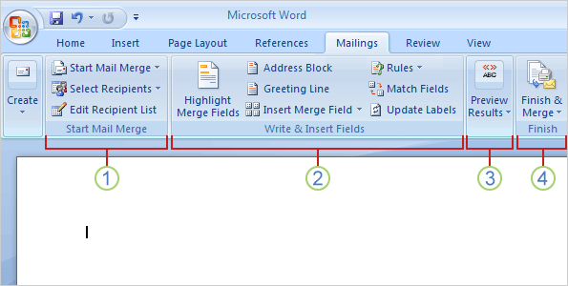
Did you notice that the commands in the Mailings tab become available as you step through the wizard?
The Ribbon is also a handy way to do a mail merge and the process is very similar to the steps in the wizard.
Using the Ribbon, you’ll have access to more features, such as automatic checking, which looks for errors before you complete the merge.
Mail merge: Use mail merge for mass mailings
Notes:
There are also advanced elements, such as using fields to perform actions or calculations within the main document.

Slide 47

The commands you use on the Mailings tab are in these four groups.
Start Mail Merge. This is beginning point where you pick a document type and then select, create, or edit the recipient list.
Write & Insert Fields. Here’s where you can insert the merge fields, match your fields, and use Rules to perform actions in your documents.
Mail merge: Use mail merge for mass mailings

Slide 48


The commands you use on the Mailings tab are in these four groups.
Preview Results. Besides viewing the individual merged documents, you can use an automatic error checking feature.
Finish. Complete the merge and combine your individual documents into one comprehensive document, or print them out, or send them electronically.
Mail merge: Use mail merge for mass mailings

